Slide 1
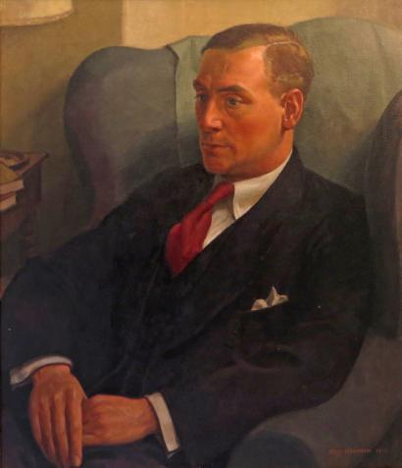
Travel Awards
Henry
Morris
Memorial Trust

Slide 2
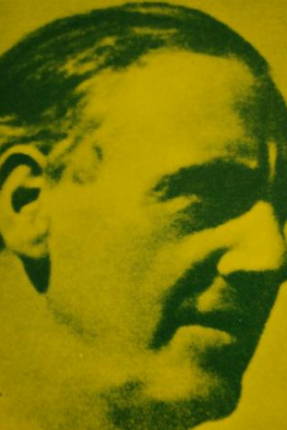
Who was Henry Morris?
Henry Morris was born in 1889.
He was Chief Education Officer in Cambridgeshire for over 30 years.
He re-organised the county's education provision. He did this with imagination, determination, and vision.
He wrote a Memorandum which led to the founding of the Village Colleges.

Slide 3
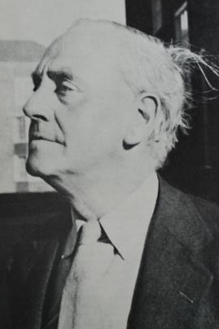
Henry Morris was an outstanding man.
Henry Morris was one of the greatest figures in education of the twentieth century.
Henry Morris died in 1961.

Slide 4
Remember Henry Morris
After Henry Morris died, a group of his friends decided to remember him by setting up the Henry Morris Memorial Trust.
The Trust has a website:
www.henrymorris.org

Slide 5
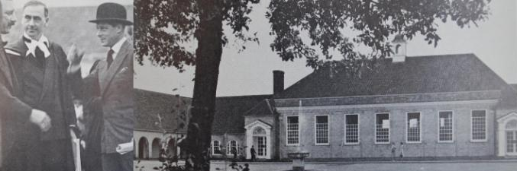
What does the Henry Morris Memorial Trust do?
The Trust has a fund, and this fund is used to grant awards for travel and home-based projects.
Young people in Cambridgeshire aged 13-19 can apply.
You can apply alone, or with a friend or friends.

Slide 6
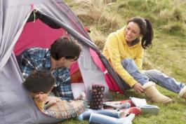
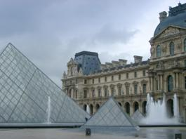
What can you get a Travel Award for?
Henry Morris Memorial Trust
The Trust funds travel or projects which are substantially planned by you.
The Trust does not fund gap years, foreign exchanges, school course-work, simple holidays or trips managed and planned by the school or another organisation.

Slide 7
Examples of what might be funded:
Travel abroad - Your trip might take you overseas – for example, a trip to France to investigate the history of the piano at the Paris Museum of Music.
Travel in Britain - You may want to travel somewhere in Britain – for example, a bird-spotting trip to Land's End.
A project at home - Alternatively, you may have a home-based project – for example, you may want to build a RAKU kiln in your back garden.
Important! There must, however, be some PURPOSE in what you plan to do.

Slide 8
What else should I know?
Stuck for ideas?
Check out the Trust’s website to see examples of projects funded in the past. Start your research for ideas now. Speak to family, friends and teachers for advice.
Can mum or dad accompany the trip?
If any adult accompanies your trip, it must be in a 'care and protection' role only. In this case, you will need to reassure trustees that you have substantially planned and are managing your project.
Find the Henry Morris Memorial Trust website at:
www.henrymorris.org

Slide 9
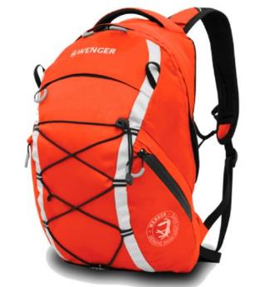
How much can I apply for?
In 2016 the Trust gave awards to 39 individuals.
Awards ranged from £40 to £500.
You must know how much your trip will cost and be prepared to raise some of this money yourself if the Trust does not cover all of your project costs.

Slide 10
Reporting on your trip
If awarded funding, then you have to report back to the Trust on how your trip went. There are tips on the website for how you might do this.
What do you need to produce? The choice is yours - and is limited only by your imagination and skill. You might put together a diary, scrapbook, slideshow, video, digital book….
Also, there’s a cash prize for the best report submitted!

Slide 11
What next? – The timeline
Nov – Dec: Do your research and plan your project.
Jan: Complete your application. Applications must be submitted by 31 January.
Mar: Applicants are invited for interview in Cambridge in early March.
Apr – Sep: Your travel/project takes place some time within this period.
Sep: You submit a report on your project to the Trust by 30 September.

Slide 12
I’m interested in this
If you want to do something with other people, get your group together and agree plans. Make sure you get approval from your parents. Find out about travel, accommodation and costs. Remember, whatever you do, it must have a PURPOSE.
Everyone in a group has to fill in a separate application form. The application form is on the Trust’s website.

